Slide 1


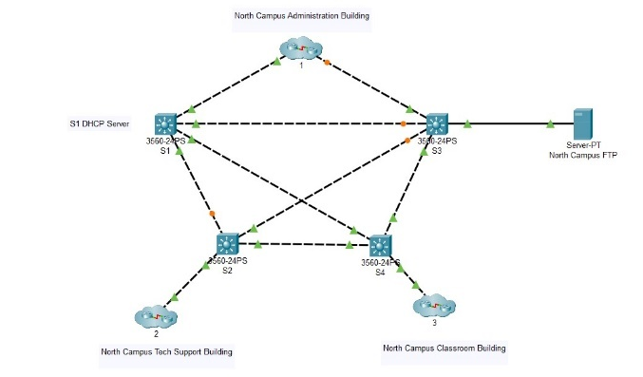
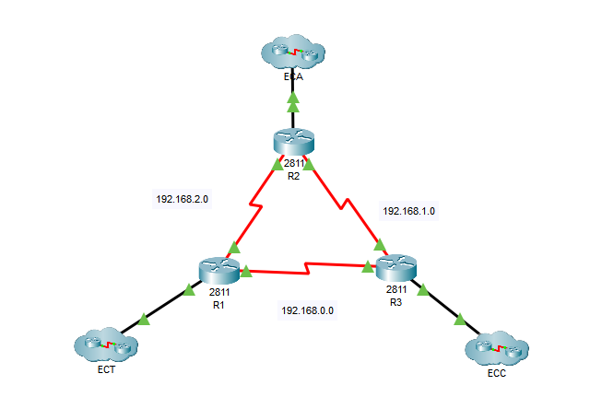
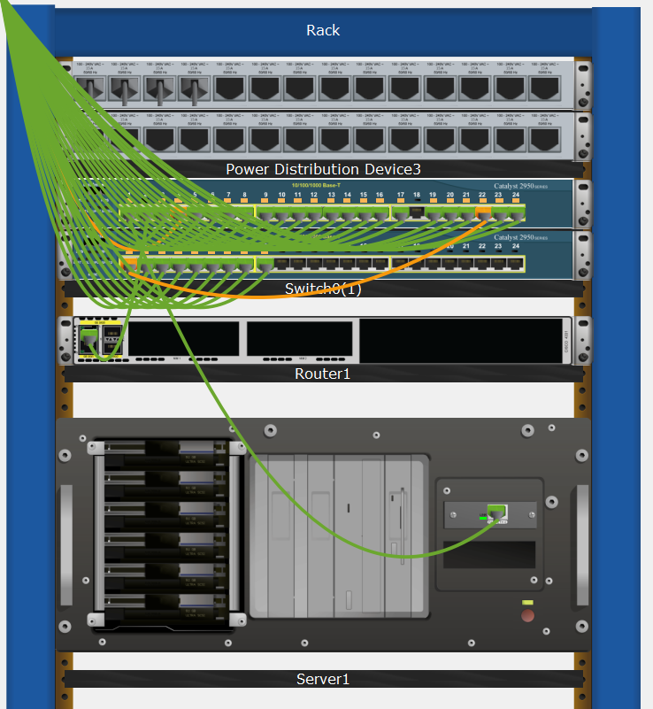
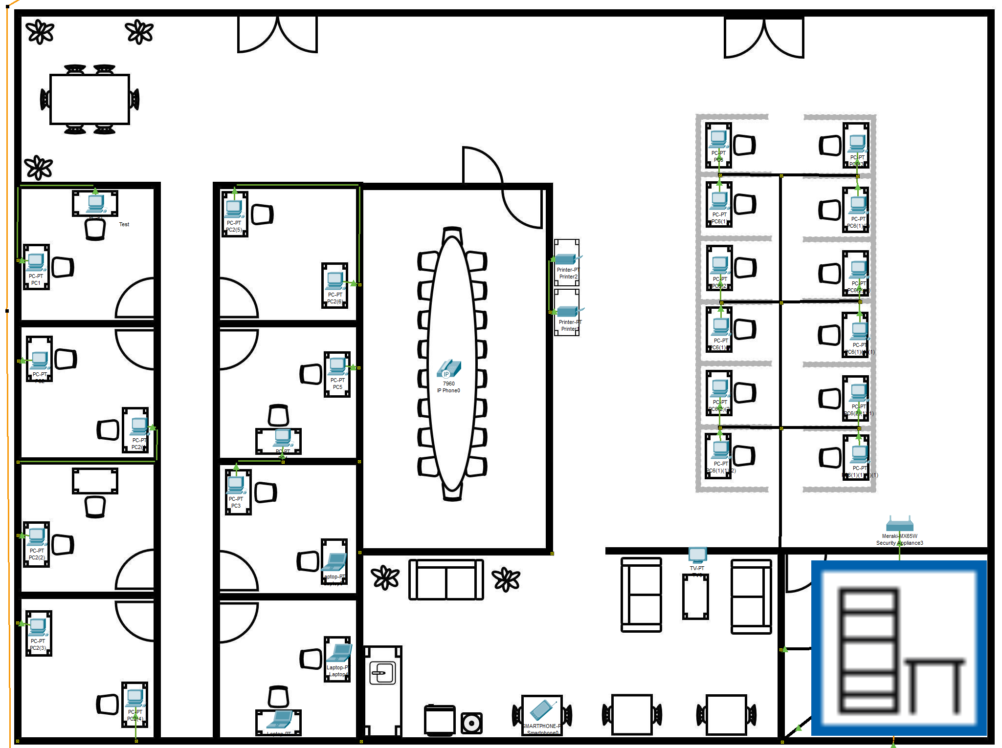
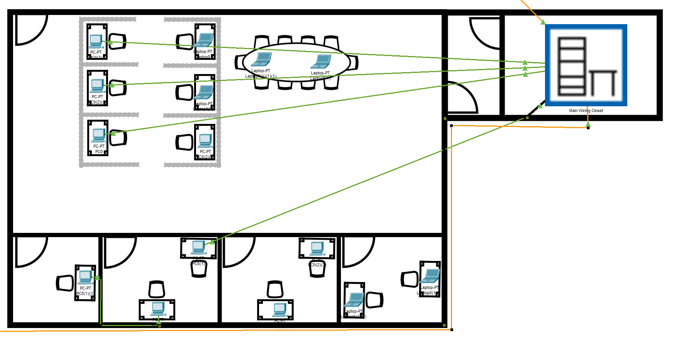
Senior Capstone: Campus Network Architecture
Chase Curtis¹, Zion Page², David Schmale³
¹ ccurtis@aggies.ncat.edu, ² ztpage@aggies.ncat.edu, ³ daschmale@aggies.ncat.edu
Problem Statement
Services
Logical Topology Examples
A new local community college has asked for assistance building their network and creating the web interface. The team must build the school network structure and configure all devices for all buildings so each device can communicate locally and on the internet. The website will need to be user-friendly and functional for all new students and faculty members. The cost for this project will be discussed with the team and the school dean before, during, and after the project’s completion.
Services provided at each location
IPv4/IPv6
Layer 3 Switches
DHCP
FTP
Email
DNS
IP Subnetting
Subnet | Location
172.16.0.1/172.16.1.1 | North campus
172.16.2.1/172.16.3.1 | East campus
172.16.4.1/172.16.5.1 | West campus
Deliverables
Figure 1: Logical layout of the admin building
A full network simulation consisting of:
Nine distinct locations
West, North, and East campuses
Three areas on each campus:
IT, Admin, and a Classroom
Wired networks
Wireless networks
Documentation:
Summary of all equipment
Explanation of IPv4/IPv6 subnetting
Router configurations
Physical topologies
Logical topologies
Table 1: Subnet utilization across the campus
Hardware Used
Network appliances:
Nine Cisco 4331 routers
Twelve Cisco 2960 switches
Servers:
Various application-specific servers
Wireless hardware:
Cisco WRT300N wireless AP
User appliances:
Desktop and laptop computers
Printers
Figure 2: Logical layout of network clusters
Physical Topology Examples
Figure 3: Typical physical rack layout
Figure 4: Physical administration building layout
Figure 5: Physical classroom layout

